Slide 1
Case | Recruitment
Integration Developer

Slide 2
Overview
New email subscribers are obtained using facebook leads ads.
The current approach is inefficient
Target is to automate the process and make it more efficient

Slide 3





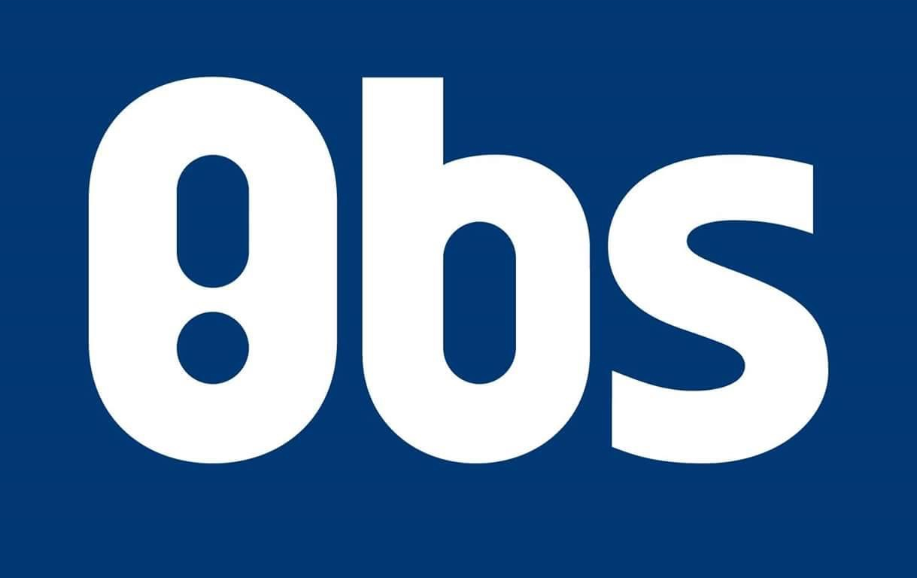
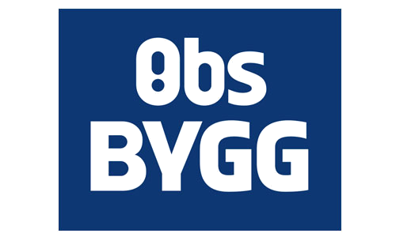
Case
Facebook offers two approaches to retrieve leads. Which one would you choose? Why?
How would you architect the various steps of this process?
Where and how do you think a cloud environment could help?

Slide 4
Approach
Facebook offers two approach to retrieve leads
Bulk read using API
Webhooks

Slide 5
Approach
The target here is to add new subscribers so that they can receive new newsletter.
Webhooks approach would have been more effective if the target was to perform a task as a reaction of an action i.e. submitting the perform in this case and then receiving the next news letter. A reaction could be calculating and sending an offer.
Also, we would have to create a web app that would always be running and listening to call backs. This I think would have been overkill just adding new subscribers.
Not so sure about the target system. Is it on prem or is coop using the cloud version. How are the API’s. It would not be good of we ended up creating a new file for each subscriber.
We will still end up with placing a backup retry system in place in case of failures.

Slide 6
Approch
The bulk read approach will be a better suit in this case.
No need to have a dedicated resource running as the solution can be implemented using the serverless approach.
Would be cost effective in this case as serverless appraoch is useful when we need to perform singular tasks and not complex operations
For adding new subscribers we can implement a time triggered function that fetches all new subscriber.
With the facebook api filtering parameter we have the flexibility to fetch responses from the time we last fetched and onwards therefore we won’t always end up fetching all data for no reason.

Slide 7
Steps for designing the solution
Understanding the requirements
Planning
Discussion
Finalizing the design
Implementation plan
Implementation
Prototype and testing
Delivery

Slide 8
Cloud Environment
Alot of benefits of using cloud and all those arguments can be used here to justify why should we use cloud for this solution as well
Cloud provides us with options like serverless
With traditional middleware platforms, you must often make significant capital investments in procuring licenses and infrastructure, forcing you to "build for peak" and creating inefficiencies. Cloud provides multiple pricing models that generally let you pay for what you use.
Cloud environments are getting better with every passing day and it is a growing ecosystem of connectors which can be used to create workflows easily

Slide 9
My Solution
Created a skeleton of a possible solution.
Present briefly….

